Slide 1
Stack
Data Structures
CS 2014
By
Marwa M. A. Elfattah

Slide 2
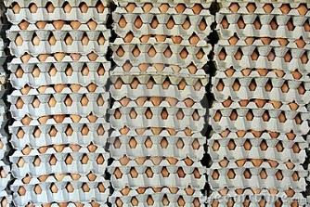
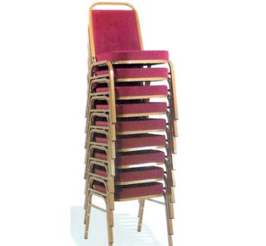




Stack – What?

Slide 3
Stack – What?
A stack is Linear - non-primitive data structure.
Stack is Ordered List of Elements of Same Type.
In Stack, all Operations are permitted at only one end called Top.
So, the stack is called Last-in-First-out (LIFO)

Slide 4
Stack – What?
Add (20)
Add( 5)
Add(30)
Delete
Delete
Add(0)
Add( -3)
30
-3
5
0
20

Slide 5
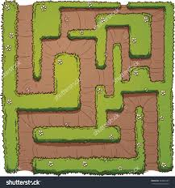
Stack Applications

Slide 6
System Stack
M(){
...
N();
...
O();
...
...
...
...
}
N(){
...
}
O(){
...
i=2
Q(i);
...
}
Q(int i){
...
If (i>1)
Q(i-1);
...
}
Q(1)
Q(2)
N()
O()
M()

Slide 7
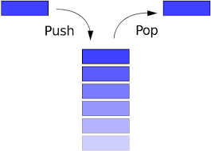
Stack
?
Implementation
User View

Slide 8
Operations Performed On Stack
Create the stack, leaving it empty.
Determine whether the stack is empty or not.
Determine whether the stack is full or not.
Push a new entry onto the top of the stack
Pop the entry off the top of the stack.

Slide 9
Stack Contiguous Implementation
Each stack item is adjacent in memory to the next stack item, and so stack items are kept in an array.
The top position is kept in an integer field.
The top and the data array are grouped in a struct.
#define MAX 10
typedef char EntryType;
typedef struct{
int top;
EntryType entry[ MAX ];
} StackType;
char
10

Slide 10
Stack Contiguous Implementation
Initialization:
  Pre: None.
  Post: The stack is initialized to be empty.
  void CreateStack(StackType *s){
  s->top = -1;
  }

Slide 11
Stack Contiguous Implementation
Stack empty operation:
  Pre: The stack is initialized.
  Post: If the stack is empty (1) is returned. Otherwise (0) is returned.
  int StackEmpty(StackType s){
  return (s.top==-1);
  }

Slide 12
Stack Contiguous Implementation
Stack full operation:
      Pre: The stack is initialized.
  Post: If the stack is full (1) is returned. Otherwise (0) is returned.
  int StackFull(StackType s){
  return (s.top==MAX-1);
  }

Slide 13
Stack Contiguous Implementation
Push operation:
  Pre: The stack is initialized and is not full.
  Post: Item is added to the top of the stack.
  void Push( EntryType item, StackType *s ){
  s->entry[++s->top] = item;
  }
  S->top++;
  S->entry[s->top]=item;

Slide 14
Stack Contiguous Implementation
Push operation with another specification:
  Pre: The stack is initialized.
  Post: If the stack is not full, item is added to the top of the stack. Otherwise, an error message is displayed and the stack is left unchanged
  void Push( EntryType item, StackType *s ){
  if (s->top == MAX-1)
  printf(“Error: Stack Overflow”)
  else
  s->entry[++s->top] = item;
  }
  NOW: Which specification is better ???

Slide 15
Stack Contiguous Implementation
Pop operation:
  Pre: The stack is initialized and is not empty.
  Post: The top element of the stack is removed from it and is assigned to item.
  void Pop( EntryType *item, StackType*s ){
  *item = s->entry[s->top--];
  }

Slide 16
Stack Contiguous Implementation
Pop operation with another specification:
  Pre: The stack is initialized.
  Post: If the stack is not empty The top element of the stack is removed from it and is assigned to item. Otherwise, an error message is displayed and the stack is left unchanged
  void Pop(Entry Type*item, Stack type*s){
  if (s->top == -1)
  printf(“Error: Stack underflow”)
  else
  *item = s->entry[s->top--];
  }
  NOW: Which specification is better ???

Slide 17
Using Of The Stack

Slide 18
Exercise
Assume that we need to read a line of text and write it back in a reverse order.

Slide 19
StackType stack;
//Initialize the stack to be empty
CreateStack(&stack);
item = getchar();
while (!StackFull(stack)&& item!= '\n'){
//Push each item onto the stack
Push(item, &stack);
item = getchar();
}
while (!StackEmpty(stack)){
//Pop an item from the stack
Pop(&item, &stack);
putchar(item);
}

Slide 20
Exercise
As a user for the stack ADT, write the StackTop function which return the top element of the stack and left the stack unchanged
  EntryType StackTop(StackType * s){
  EntryType item;
  pop(&item, s);
  push(item, s);
  return (item);
  }

Slide 21
Exercise
Rewrite the previouse function as a part of stack ADT
  EntryType StackTop(StackType * s){
  EntryType item;
  item = s->entry[s->top];
  return (item);
  }
  Return (s->entry[s->top])

Slide 22
Thank you

